Slide 1
Pedestrian Detection
Steven Jennings

Slide 2
Python > Matlab
Open Source Computer Vision (OpenCV)
Please no haters ( ͡° ͜ʖ ͡°)

Slide 3
Overview
Read video and text data
Detect potential crash from data
Fetch timestamp from detection
Sample images from video starting at detected timestamp
In intervals of 30 frames
Run all sample images through pedestrian detection

Slide 4
Data Analysis
Just used GPS data
Would have been better with both Sensor and GPS data
Acceleration = First derivative of velocity, provided by GPS data
Only care about the magnitude (make all values positive)
Detect highest acceleration value
Fetch timestamp from detected acceleration value

Slide 5
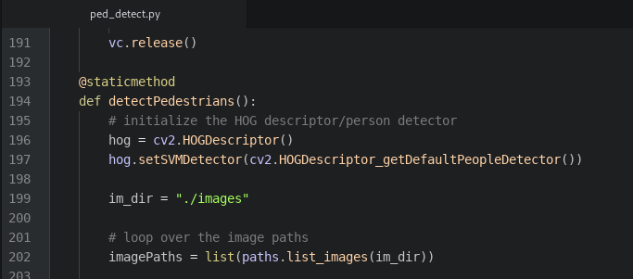
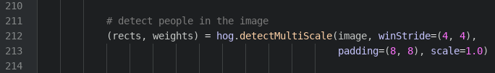
The Pedestrian Detection Code

Slide 6
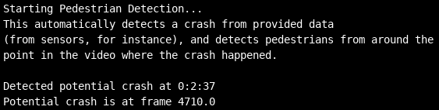

Slide 7
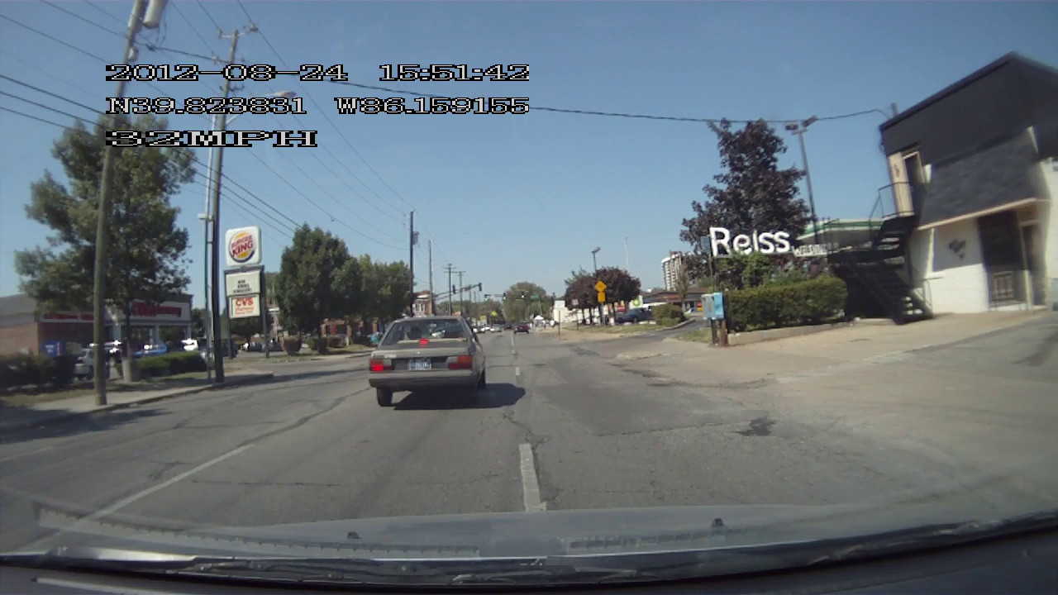
What’s happening at 2:37? (Frame 4710)

Slide 8
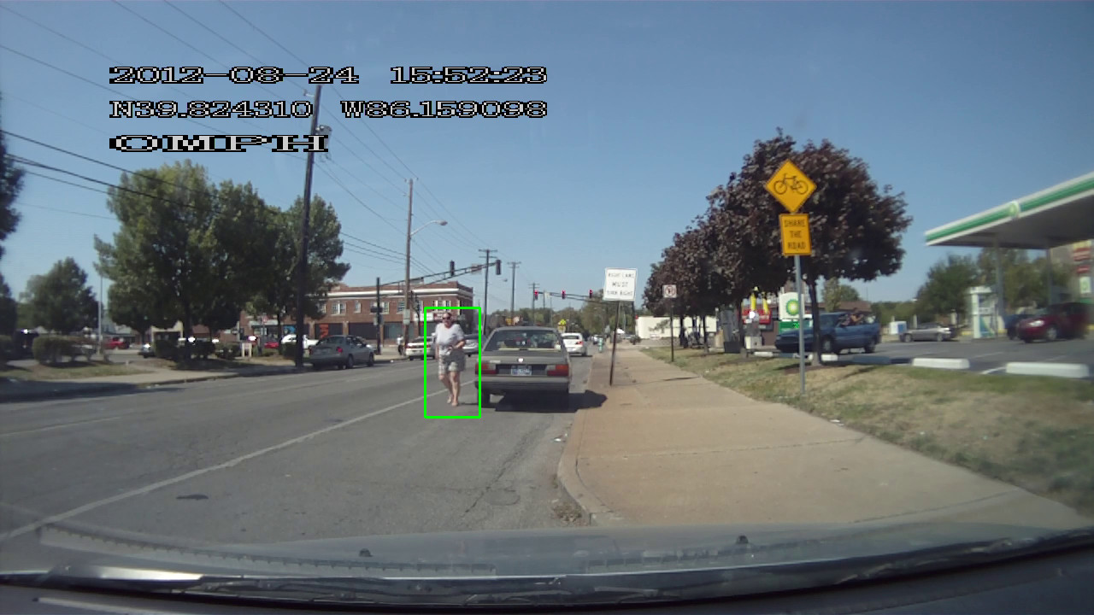

Slide 9
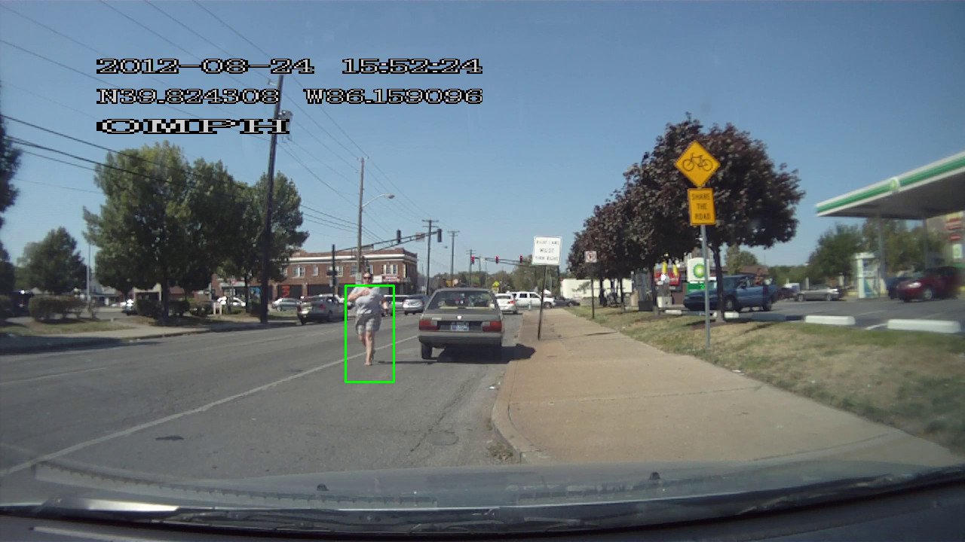

Slide 10
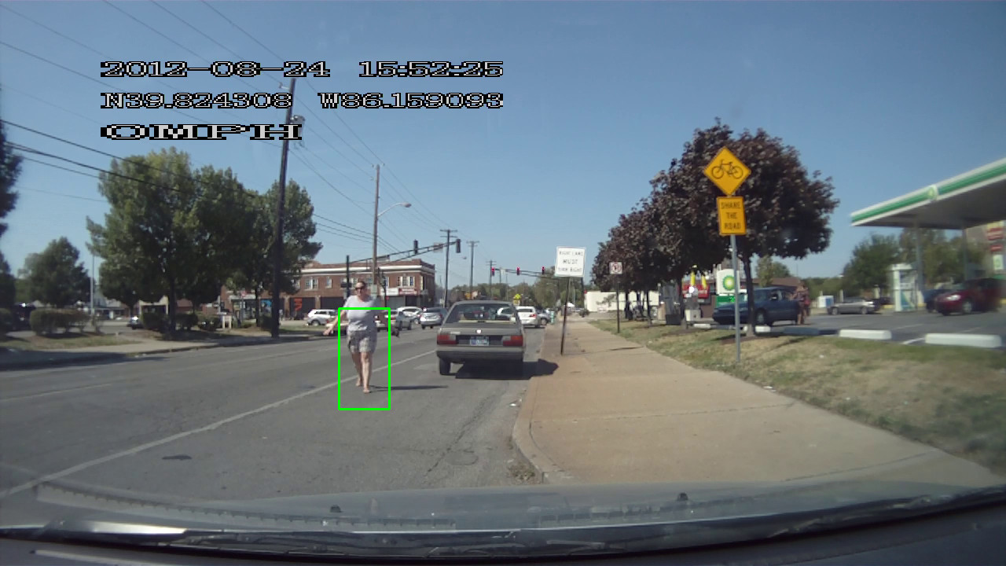

Slide 11
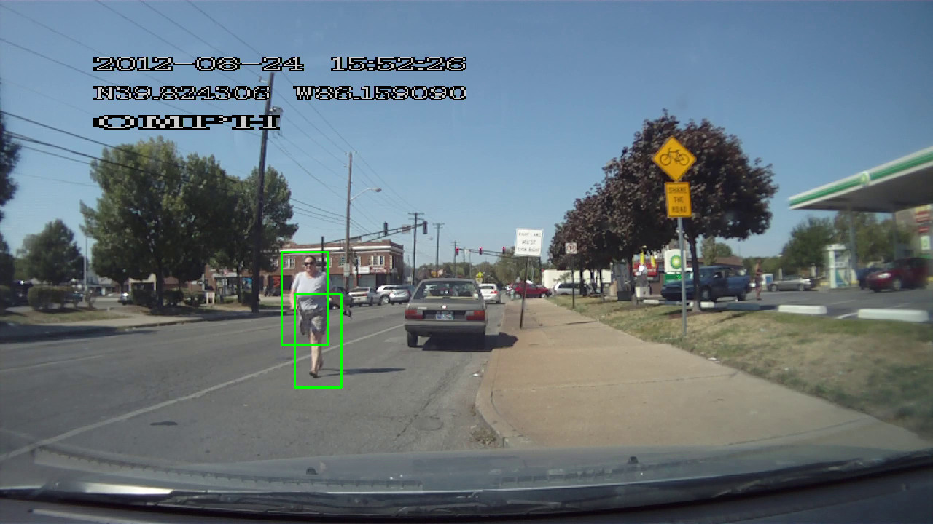

Slide 12
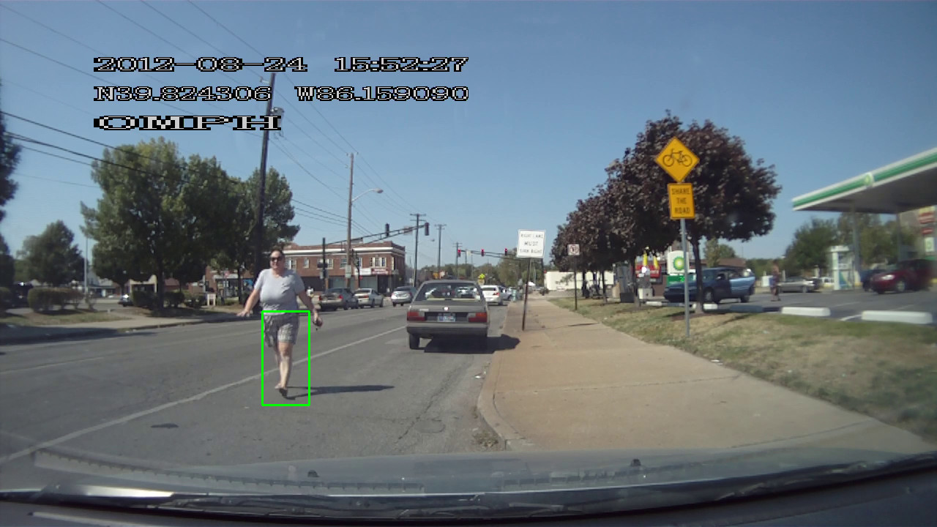

Slide 13
Final Thoughts
If I was totally in charge of designing a pedestrian detection system, what would I do?

